Slide 1
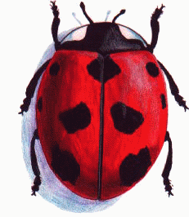
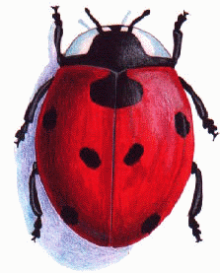
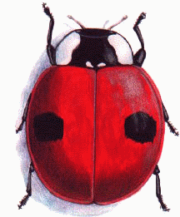
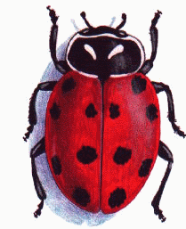
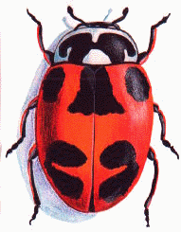
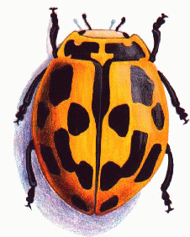
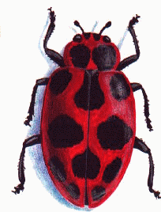
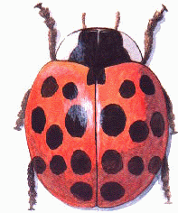
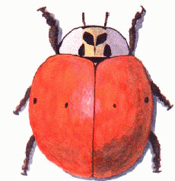
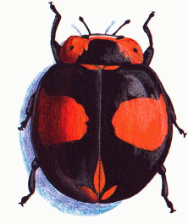
Nine-Spotted Ladybug Coccinella novemnotata
Seven-Spotted Ladybug Coccinella septempunctata
Two-Spotted Ladybug Adalia bipunctata
Convergent Ladybug Hippodamia convergens
Parenthesis Ladybug Hippodamia parenthesis
Fourteen-spotted Ladybug Propylea quatuordecimpunctata
Spotted Ladybug Coleomegilla maculata
Multicolored Asian Ladybug Harmonia axyridis

